Slide 1


EDP CAPSTONE
BANKING INDUSTRY
LOAN RISK
FROM DATA TO INSIGHT TO STORY
Notes:
To be used as 1st and Last slide

Slide 2

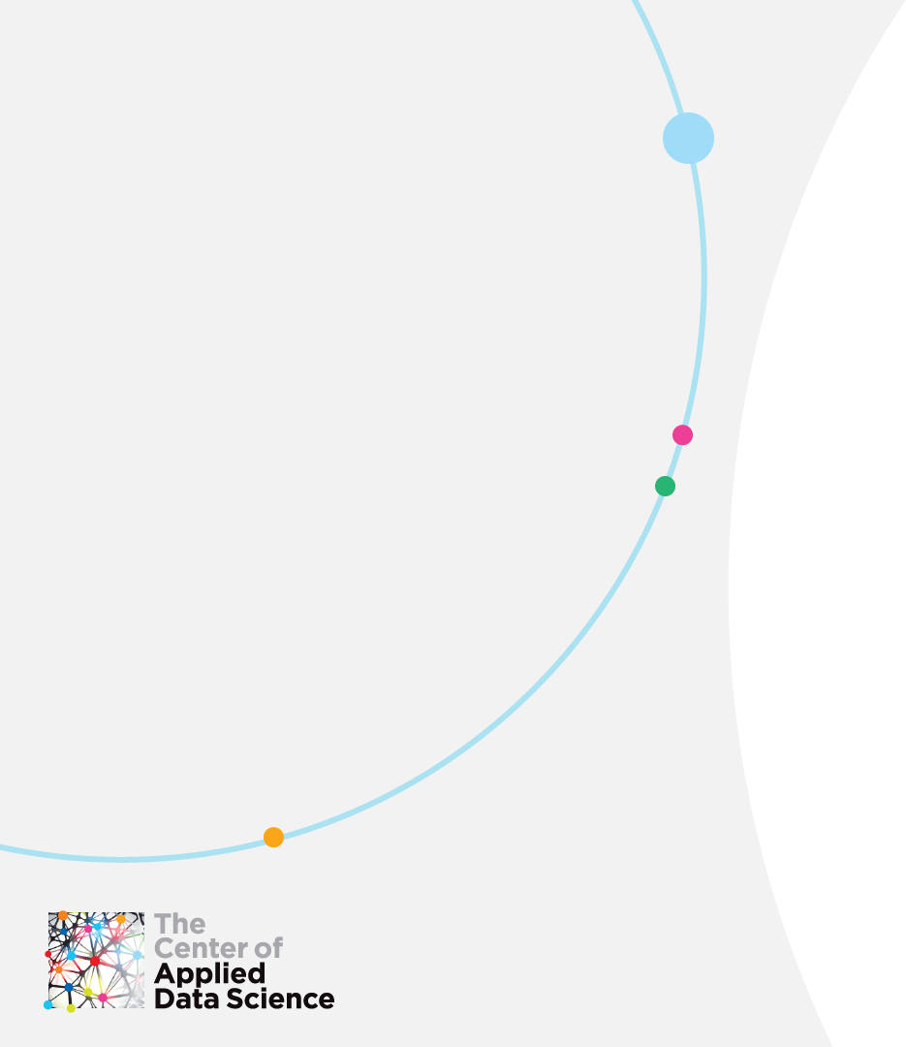
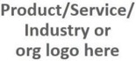
Introduction
Notes:
a capstone project is a multifaceted assignment that serves as a culminating academic and intellectual experience for students, typically during their final session
Capstone projects are generally designed to encourage students to think critically, solve challenging problems, and develop skills such as Exploratory Data Analysis, Real world problem handling, working on real world dataset and usecases and apply the knowledge gained throughout the Cohort to a real world use case
This Require you to have some research skills, teamwork, thorough planning, self-sufficiency, or goal setting

Slide 3
Where Theory Meets Application Introducing CADS Capstone programs
The CADS Capstone program is a project-based mentorship session aimed at encouraging application of skills learned in CADS technical courses towards real-world problems
Traditionally conducted at the end of a learning track
Duration is 2 days
Focused application in client domain based on curated data
Notes:
What Exactly is a Capstone Project?
A capstone project or capstone experience involves the identification of an existing problem in a real-world setting and
the application of learned skills and methods to develop a solution that addresses the problem directly.
In some cases a capstone project will be geared toward research, while others are more oriented toward problem solving.
Solutions are usually interactive, meaning they can be implemented and used.

Slide 4
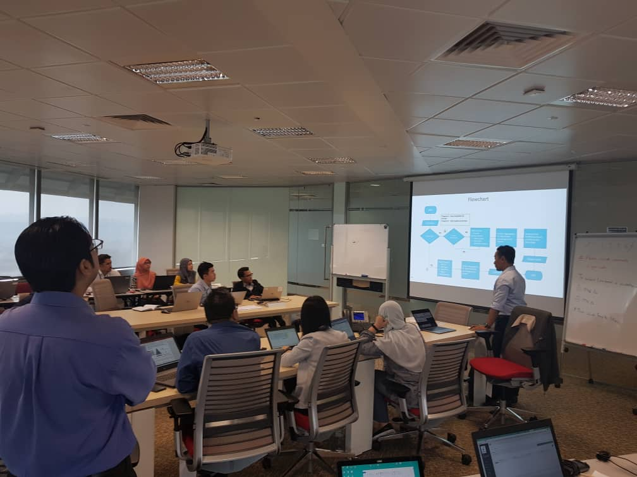
Where Theory Meets Application Introducing CADS Capstone programs
Participants work in groups to tackle business problems using real-world data
CADS data scientists provide on-site feedback for a more interactive learning experience
Notes:
Each Team will consist of 3 to 4 Members, The idea is to work as a team to solve the problem, come up with new ideas, perform all skills that you have acquired over the course of these courses. It’s time to bring everything in one place and apply them all together

Slide 5
Loan Risk
Capstone
Notes:
Section separator slide

Slide 6

Loan Risk Capstone Capstone sessions designed with rapid mobilization in mind
Utilize training skill set + Data practitioner knowledge to work with data
Mentors are available for guidance
No assistance to be provided
Mentors inject experience where necessary
Objectives:
Encourage a structured approach towards analytical, visualization and storytelling skills
Develop solutions for real world use cases
Notes:
We are here to guide you, but you guys are the domain experts, you know this type of data better then anyone, So apply that domain knowledge plus the knowledge and skills that you have gained.

Slide 7
Loan Risk Capstone Capstone sessions designed with rapid mobilization in mind
Customized instance of CADS’s Capstone program tailored for applying Exploratory Data Analysis technique, aka Descriptive Statistics, on real-world dataset
Focused application in performing data analysis, visualization and storytelling using a Real-world automation dataset to detect sensors defects in a hazardous material storage facility

Slide 8
Loan Risk Capstone Topic What is “From Data To Insight”?
From data to insight is the data practitioners’ journey to transform data from its raw form into beautiful visuals complete with clear narratives. The goal of the Capstone is to use Descriptive Statistics to break down complex data into simple summaries to reveal insights.
By utilizing effective visualization techniques and eloquent storytelling, data is transformed into knowledge.

Slide 9
Loan Risk Capstone USE CASE
CHECKLIST FOR PREPARATION
No. | Checklist Item | Requirements | Remarks & Reference
1 | Problem Statement | Identify Top 3 factors that determines the loan application being approved or rejected, and optimize successful applicants' procedure based on defaulted cases (to reduce defaulted cases through better approvals) | EDP Excel for Data Analytics
2 | Potential Solution | Create and present a narrative to deliver the simplified method to categorize successful and unsuccessful applicants to management, and propose measures to curb defaulted cases | EDP Data Storytelling
3 | Dataset & Volume | Dataset is provided as per below: 1) Dataset in ".csv" Format 2) Dataset Structure as per Schema sample provided 3) Dataset Volume of a minimum of 600 rows | Refer to the slide "Data Sample" Dataset is provided

Slide 10
Loan Risk Capstone USE CASE CATEGORIZE SUCCESSFUL AND UNSUCCESSFUL APPLICANTS BASED ON THE TOP 3 CRITERIA, OPTIMIZE SUCCESSFUL APPLICANTS' PROCEDURE BASED ON DEFAULTED CASES
Loan approval can be a very tedious in the banking industry, particularly in identifying and weighing the risk of approving worthy potential customers. The ability to analyse previous records to identify patterns for future application and improving the loan approval process would be a very essential skill in reducing the risk of default.
As a data practitioner, you are required to identify the Top 3 criteria that determine the success or reject of loan applicants; and to improve the loan applications based on the loan defaulted cases; and provide the insight on how to categorize the variables that determine such results.
Apply Descriptive Statistics tools on the dataset provided and complete the visual insights in a 3-slide narrative for storytelling at the end of the Capstone.

Slide 11
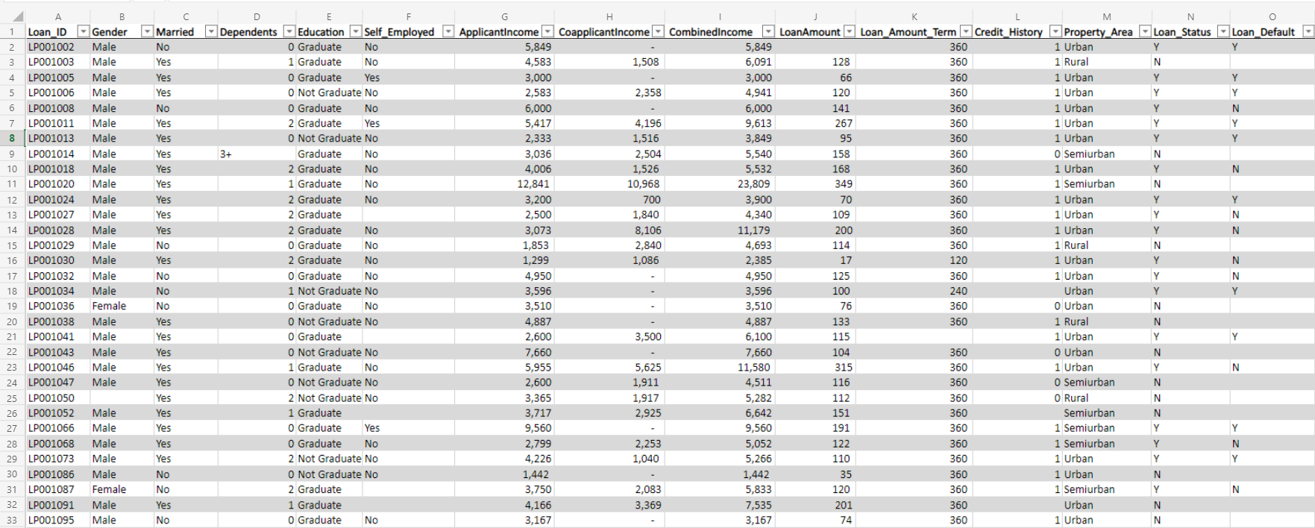
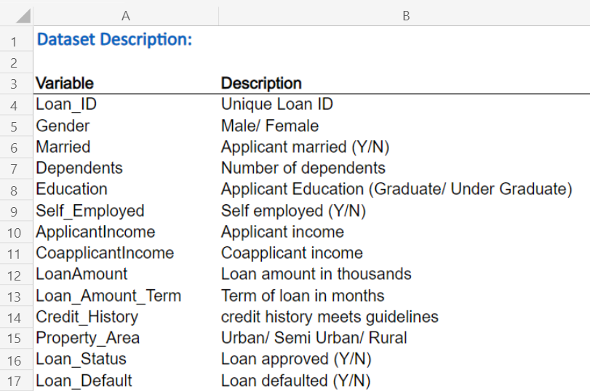
Loan Risk Capstone DATASET CATEGORIZE SUCCESSFUL AND UNSUCCESSFUL APPLICANTS BASED ON THE TOP 3 CRITERIA, OPTIMIZE SUCCESSFUL APPLICANTS' PROCEDURE BASED ON DEFAULTED CASES

Slide 12
Loan Risk Capstone Instructions
Form Groups of 2 to 3
Ideally, members should cut across various risk functions
For the potential EDP candidate:
Perform data analysis using Descriptive Stats and Excel Pivot & Slicer tools
Visualize insights using Excel / Tableau charts and dashboard
Tell your story with eloquent narrative and vibrant visuals
Each group will be given 10-15 minutes (inclusive of Q&A) to present their findings
Present a 3-slide narrative of your data storytelling

Slide 13

Loan Risk Capstone Email the following to your mentor
Excel workbook containing all features used for analysis
PowerPoint slidepack containing the storytelling

Slide 14
Loan Risk Capstone Tips for success
Leverage your team
Manage your time well
Remember to document your workflow
Report only what’s important

Slide 15
Loan Risk Capstone Score Breakdown
Use of Descriptive Statistics (EDA tools)
Approach on Dataset
Use of formulas, Pivot tools
Use of charts and visuals, inclusive of heatmaps and sparklines
Storytelling Skills
Visuals
Delivery

Slide 16

Good luck!
Notes:
To be used as 1st and Last slide

